Slide 1




PROJECT ON
BANK CUSTOMER SEGMENTATION
Presented By:
Name : Y.JYOTHI
Batch : 456
Branch : DILSUKHNAGAR

Slide 2


ABOUT ME
My name is Jyothi Yadavalli.
I have completed my Master of Science (MSc) in Bioinformatics
Linked In: linkedin.com/in/jyothi-yadavalli-202a4a315

Slide 3
AGENDA
Introduction
Business Problem Statement
Data Overview
Key Insights
  Customer Demographics
  Transaction Behavior
  Customer Segmentation
  Profitability & Risk
Recommendations
Conclusion

Slide 4

INTRODUCTION
  Banks generate a large amount of customer and transaction data every day.
  Analyzing this data helps banks understand customer behavior, spending habits, and risk levels.
  This project uses Power BI to segment bank customers and convert raw data into useful insights.
  The analysis supports better decisions for customer retention, increasing revenue, and managing risk.

Slide 5

PROJECT OBJECTIVE
  To understand customer details like age, gender, and location through clear visual analysis.
  To study how customers spend and how their transactions change over time.
  To divide customers into groups such as Loyal, New, and Lost using RFM analysis.
  To find out which customers bring more profit and which ones may have higher risk.
  To create an interactive Power BI dashboard that helps the bank make better and faster business decisions.
TRADE WAYS

Slide 6

BUSINESS PROBLEM
  In today’s banking industry ,oraganizations generate a large volume of customers and transaction data daily
  Banks struggle to identify valuable customers and understand their transaction behavior.
  Managing high-risk customers while maintaining profitability is a major challenge.
  Banks need effective customer segmentation to increase loyalty and revenue.

Slide 7
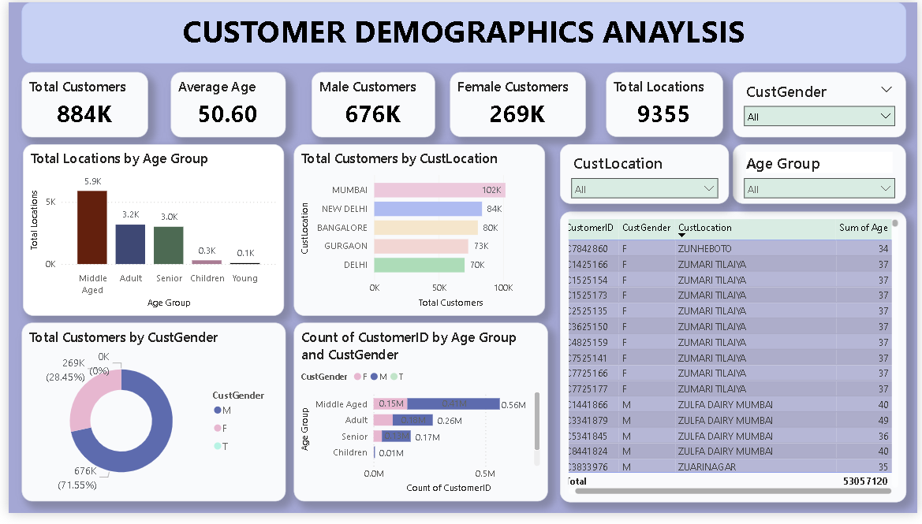

Slide 8
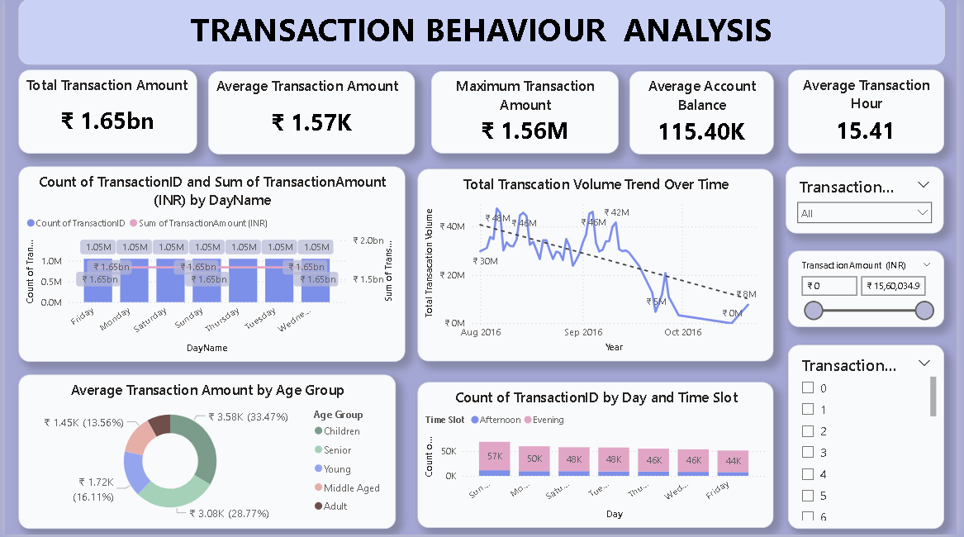

Slide 9
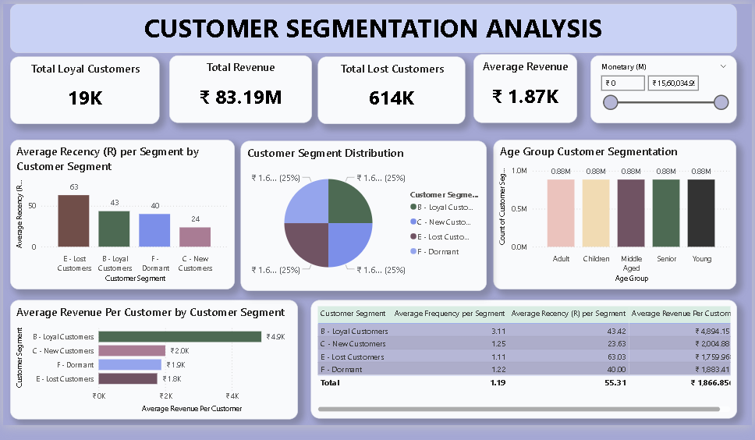

Slide 10
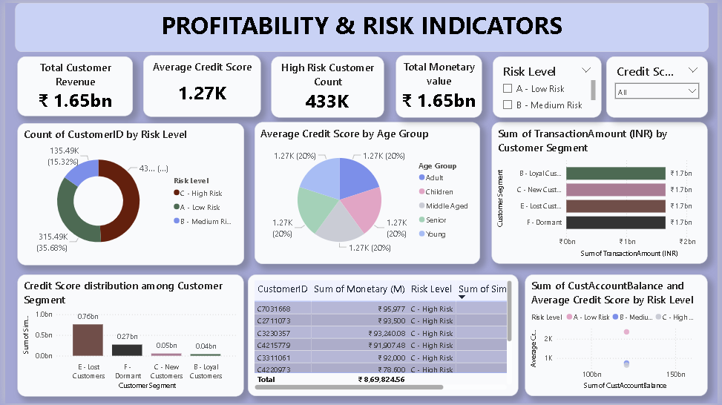

Slide 11
KEY INSIGHTS
  The bank serves ~884,000 customers with an average age of ~50 years, dominated by male customers across 9,000+ locations.
  Total transaction value is ~₹1.65 billion, but transaction volume shows a declining monthly trend, indicating reduced customer engagement.
  Loyal customers form a smaller segment but generate the highest revenue per customer, significantly outperforming new and lost customers.
  A large share of customers fall under medium and high-risk categories, with high-risk customers forming the majority of the risk pool.
  Moderate-risk customers contribute the highest transaction value, making them the most stable and profitable segment.
  Transactions peak during afternoon and evening hours, with the average transaction value ~₹1.57K and a maximum single transaction of ~₹1.56M.
TRADE WAYS

Slide 12



CONCLUSIONS
  The bank has a large and diverse customer base, mainly middle-aged and adult customers.
  Transaction activity is consistent, with higher activity during specific days and time slots.
  Loyal customers generate higher revenue, while a large number of customers fall under lost or dormant segments.
  A significant portion of customers belong to medium and high-risk categories.
  Some high-risk customers also contribute high revenue, requiring careful monitoring.

Slide 13

RECOMMENDATIONS
  Focus on loyal customers by offering rewards, personalized offers, and premium services to retain them.
  Re-engage lost and dormant customers through targeted campaigns and special incentives.
  Monitor high-revenue but high-risk customers closely to reduce financial risk.
  Use customer age, location, and transaction patterns for targeted marketing strategies.
  Improve risk management by adjusting credit policies for high-risk segments

Slide 14


THANK YOU!

